Slide 1

Istio Workshop Kubecon Copenhagen

Slide 2
An open services platform to manage service interactions across container- and VM-based workloads
Istio

Slide 3

Distributed world
The trends of containerization, microservices and hybrid/ multi-cloud deployments have created more distributed applications than ever.
Developers, devops and secops personnel need modern tools to secure, manage and monitor distributed applications.

Slide 4
Everybody got all fired up about Kubernetes and microservices and then were like ‘Oh, s--t, what’s going on?’ Istio gives us a view of our entire system and lets us find trouble spots.
An early adopter

Slide 5
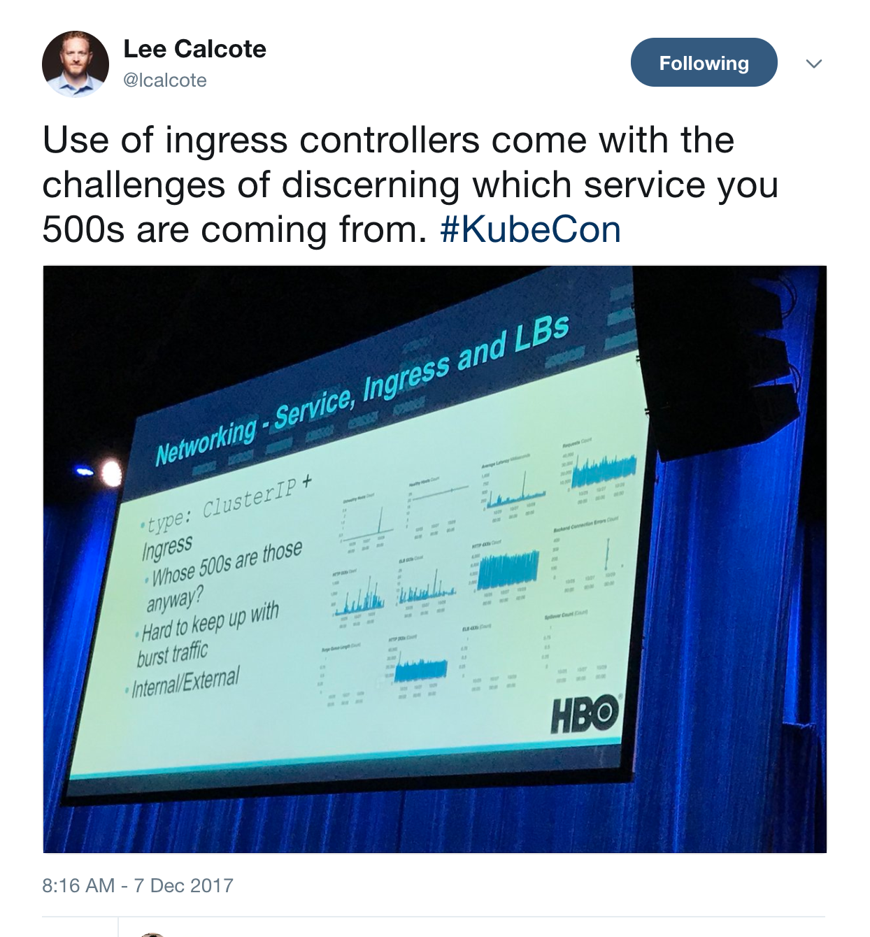

Slide 6
We bring up a new version, flip all traffic to it, and if there’s something wrong we roll the whole thing back.
Kubernetes user

Slide 7

What is a service mesh?
A service mesh provides a transparent and language-independent way to flexibly and easily automate application network functions.

Slide 8
What is a service mesh?
A service mesh provides a transparent and language-independent way to flexibly and easily automate application network functions.

Slide 9
What is a service mesh?
A service mesh provides a transparent and language-independent way to flexibly and easily automate application network functions.

Slide 10
What is a service mesh?
A service mesh provides a transparent and language-independent way to flexibly and easily automate application network functions.

Slide 11

Separate
applications from infrastructure

Slide 12

Decouple operation from development

Slide 13

Change traffic flow without changing code

Slide 14

Istio Everywhere
Secure, monitor and manage services everywhere. Kubernetes first, but not Kubernetes only.

Slide 15
What we’re going to do today
Go deep! This is not a quick get to know you -- we’ll start with installation but will be taking you through some of Istio’s most advanced features:
Installation, ingress, telemetry, distributed tracing, routing/canary deployments, service isolation, fault injection, mTLS (+SPIFFE), and RBAC

Slide 16
Where we’re going to do it
Lab: https://github.com/dcberg/istio-workshop
Half of you will be doing the lab on IBM’s Cloud Container Service.
Half of you will be doing the lab on Google Kubernetes Engine.
(after the first exercise, everything is the same)
Use the provided lab account for Exercise 1
cd ~/
git clone https://github.com/dcberg/istio-workshop

Slide 17
Find the workshop
Clone the Install to Ops repo:
kubectl config get-contexts
Make sure you have permission to create cluster role bindings:
Download kubectl version 1.7.5 if you don’t have it:
curl -LO https://storage.googleapis.com/kubernetes-release/release/v1.7.5/bin/darwin/amd64/kubectl chmod +x ./kubectl
sudo mv ./kubectl /usr/local/bin/kubectl
git clone git@github.com:ZackButcher/install-to-ops.git
kubectl create clusterrolebinding cluster-admin-binding \
--clusterrole=cluster-admin \
--user=devstar*@gcplab.me

Slide 18
Weaving the mesh
HTTP/1.1, HTTP/2, gRPC, TCP with or without TLS
Internet
sidecar
sidecar
sidecar
External
Services
HTTP/1.1, HTTP/2, gRPC, TCP with or without TLS
svcA
svcB
Outbound features:
Service authentication
Load balancing
Retry and circuit breaker
Fine-grained routing
Telemetry
Request Tracing
Fault Injection
Service A
Service B
Inbound features:
Service authentication
Authorization
Rate limits
Load shedding
Telemetry
Request Tracing
Fault Injection
Notes:
You can build a mesh using sidecars. You want your sidecars to handle both ingress and egress traffic to a service. This allows you to bake several desirable properties into the service mesh:
You can offload common functions performed inside the application code into the sidecar (such as telemetry, distributed tracing, TLS termination/initiation, etc.).
You can also add more useful features in the sidecar, such as circuit breakers, rate limits, intelligent routing for A/B testing, canary releases, etc.

Slide 19
Istio Proxy Sidecar
Each Pod needs to be updated to have the Istio Proxy Sidecar
Manual Approach
istioctl kube-inject -f guestbook/helloworld-deployment.yaml
Automated Approach with Kubernetes mutating webhook admission controller
Admission controller - piece of code that intercepts requests to the Kubernetes API server prior to persistence of the object, but after the request is authenticated and authorized
Istio modifies the individual pods and not deployments
Automated Inject is done with a webhook called istio-sidecar-injector

Slide 20
Exercise 5
Installing Istio 0.7.1 - Be sure not to install latest!

Slide 21
Exercise 6
Creating a Service Mesh with Istio Proxy

Slide 22
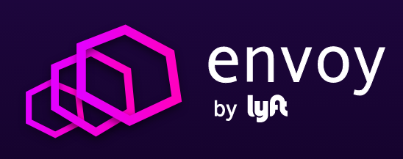
Envoy: The Data Plane
Features:
HTTP/2 & gRPC
Zone-aware load balancing w/ failover
Health checks, circuit breakers, timeouts, retry budgets
No hot reloads - API driven config updates
A C++ based L4/L7 proxy
Low memory footprint
Battle-tested @ Lyft
100+ services
10,000+ VMs
2M req/s
Istio’s contributions:
Transparent proxying w/ SO_ORIGINAL_DST
Traffic routing and splitting
Request tracing using Zipkin
Fault injection
Notes:
Decided to build our service mesh on top of Envoy, the sidecar built by the folks at Lyft.
We loved the simplicity of design, extensibility, feature set and of course performance. But what was and will be important to us is the team itself: their openness to ideas, willingness to work with the community to add various features that we wanted. It was a win-win situattion.
We have been working extensively with the Envoy team over the last 7 months adding various features (such as traffic splitting, zipkin tracing, fault injection, some of which also went into production at Lyft.

Slide 23
Istio Proxy Init Container
Init container adds iptables rules inside the pod
Traffic gets redirected to sidecar proxy
All service to service then goes through Envoy
Envoy then handles all intra-cluster traffic
Provides an abstraction so services don’t have to know details of communication, such as auth
Notes:
Prepare Proxy:
https://github.com/istio/istio/blob/282e159500b021f1c8f1b4c4dca7f58092575805/pilot/docker/prepare_proxy.sh

Slide 24
Efficiency
L7 load balancing
Passive/Active health checks, circuit breaks
Backend subsets
Affinity
Inter-service communication happens over HTTP/2
HTTP/1.1 connections are transparently upgraded
QUIC on the roadmap
TLS offload
No more JSSE or stale SSL versions.
HTTP/2 and gRPC proxying
Notes:
L7 LB
Kubernetes LB is L4 only using VIPs
Envoy supports passive and active health checking, usual benefits but can also do
Subsetting
TLS - Envoy uses BoringSSL - a modern well maintained and reliable TLS stack (used in Chrome, Android, …)

Slide 25



Istio Architecture - Putting it Together
Service A
Service B
Traffic is transparently intercepted and proxied. App is unaware of Proxy presence
proxy
proxy
Routing and load balancing config to Envoys
TLS certs to Envoys
Pilot
Mixer
Istio Auth
Policy plugin
Telemetry plugin
Notes:
Similar architecture to kubernetes control plane, agents enforce policies . In kubernetes we talk about what to run. In Istio we talk about how to secure and protect those things that are running.
Envoy can run on edge and replace nginx as Kubernetes ingress controller. Does service discovery + gRPC + http/2. Reverse proxy databases.
Inspect traffic as it passes through proxy.
Our service mesh is built using Envoy sidecars. If you look at the big picture, its very similar to a SDN.
The sidecars on the data plane carry traffic. Traffic is transparently intercepted using iptable rules in the pod namespace.
The Istio control plane takes care of managing and configuring the data plane.
The Pilot is responsible for providing service discovery to envoys and managing their configuration as well.
The mixer handles policy enforcement, while Istio-auth takes care of authentication and authorization.
We’ll talk about the mixer and Istio-auth later.

Slide 26

Pilot - Modeling the service mesh
Environment-specific topology extraction
Topology is mapped to a platform-agnostic model.
Additional rules are layered onto the model. E.g. retries, traffic splits etc.
Configuration is pushed to Proxy and applied without restarts
Consul
Custom discovery
Kubernetes
etcd
Platform Adapter
Rules API
Abstract Model
Pilot
Proxy API
Service discovery & traffic rules
Proxy
Proxy
Proxy
Proxy
Notes:
Similar architecture to kubernetes control plane, agents enforce policies . In kubernetes we talk about what to run. In Istio we talk about how to secure and protect those things that are running.
Envoy can run on edge and replace nginx as Kubernetes ingress controller. Does service discovery + gRPC + http/2. Reverse proxy databases.
Inspect traffic as it passes through proxy.
Our service mesh is built using Envoy sidecars. If you look at the big picture, its very similar to a SDN.
The sidecars on the data plane carry traffic. Traffic is transparently intercepted using iptable rules in the pod namespace.
The Istio control plane takes care of managing and configuring the data plane.
The Pilot is responsible for providing service discovery to envoys and managing their configuration as well.
The mixer handles policy enforcement, while Istio-auth takes care of authentication and authorization.
We’ll talk about the mixer and Istio-auth later.

Slide 27
Pilot Model
Services Model
Service - unit of an application with a unique name
Service Instance - pods/VMs/containers that implement the service
Service versions
Service version labels - Provides disjoint subsets from versions
Configuration Model
Notes:
L7 LB
Kubernetes LB is L4 only using VIPs
Envoy supports passive and active health checking, usual benefits but can also do
Subsetting
TLS - Envoy uses BoringSSL - a modern well maintained and reliable TLS stack (used in Chrome, Android, …)

Slide 28
Pilot proxy controller
Controls the mesh of Istio Proxies by propagating service registry information and routing rules to the destination proxies
Proxy Agent - supervisor script that generates Envoy configuration from the abstract model of services and rules, and triggers a proxy restart
Discovery Service - publish information for Envoy proxies to consume.
Notes:
L7 LB
Kubernetes LB is L4 only using VIPs
Envoy supports passive and active health checking, usual benefits but can also do
Subsetting
TLS - Envoy uses BoringSSL - a modern well maintained and reliable TLS stack (used in Chrome, Android, …)

Slide 29
Service discovery service (SDS)
Generic REST based API used by Envoy to fetch cluster member
Provides explicit knowledge of each upstream host for intelligent load balancing decisions.
Extra attributes (balancing weight, canary status) carried in the discovery API used globally by the Envoy mesh during load balancing, statistic gathering, etc.
Active health checking is used in conjunction with the eventually consistent service discovery service data to making load balancing and routing decisions
Notes:
https://www.envoyproxy.io/docs/envoy/latest/intro/arch_overview/service_discovery.html#arch-overview-service-discovery-types-sds

Slide 30
Life of a request
Service A
Service B
Service A places a call to http://service-b.
Client-side Envoy intercepts the call.
Envoy consults config (previously received from Pilot) to know how/where to route call to service B (taking into account service discovery, load balancing, and routing rules), forwards the call to the right destination.
proxy
proxy
Pilot
Mixer
Istio Auth

Slide 31
Life of a request
Service A
HTTP/1.1, HTTP/2, gRPC or TCP -- with or without mTLS
Service B
Envoy forwards request to appropriate instance of service B. There, the Envoy proxy deployed with the service intercepts the call.
proxy
proxy
Pilot
Mixer
Istio Auth

Slide 32
Life of a request
Service A
Service B
Server-side Envoy checks with Mixer to validate that call should be allowed (ACL check, quota check, etc).
proxy
proxy
Policy checks, telemetry
Pilot
Mixer
Istio Auth

Slide 33
Life of a request
Service A
Service B
Mixer checks with appropriate adaptors (policy engine, quota adaptor) to verify that the call can proceed and returns true/false to Envoy
proxy
proxy
Policy checks, telemetry
Pilot
Mixer
Istio Auth
Policy Engine
Quota Adaptor

Slide 34
Life of a request
Service A
Service B
Server-side Envoy forwards request to service B, which process request and returns response
proxy
proxy
Pilot
Mixer
Istio Auth

Slide 35
Life of a request
Service A
Service B
Envoy forwards response to the original caller, where response is intercepted by Envoy on the caller side.
proxy
proxy
Pilot
Mixer
Istio Auth

Slide 36
Life of a request
Service A
Service B
Envoy reports telemetry to Mixer, which in turn notifies appropriate plugins
proxy
proxy
Pilot
Mixer
Istio Auth
Logging plugin
Monitoring plugin

Slide 37
Life of a request
Service A
Service B
Client-side Envoy forwards response to original caller.
proxy
proxy
Pilot
Mixer
Istio Auth

Slide 38
Life of a request
Service A
Service B
Client-side Envoy reports telemetry to Mixer (including client-perceived latency), which in turn notifies appropriate plugins
proxy
proxy
Pilot
Mixer
Istio Auth
Logging plugin
Monitoring plugin

Slide 39
Kubernetes Ingress Controller
Services and pods have IPs only routable by the cluster network
Ingress -> collection of rules that allow inbound connections to reach the cluster services.
Gives Services external URL
Allows traffic to be load balanced
Terminate SSL

Slide 40
Istio Ingress Controller
Ingresses provides a gateways for external traffic to enter the Istio service mesh
Uses Envoy to route requests
Extends Istio traffic management and policy to edge services.

Slide 41
Exercise 7
Istio Ingress Controller

Slide 42
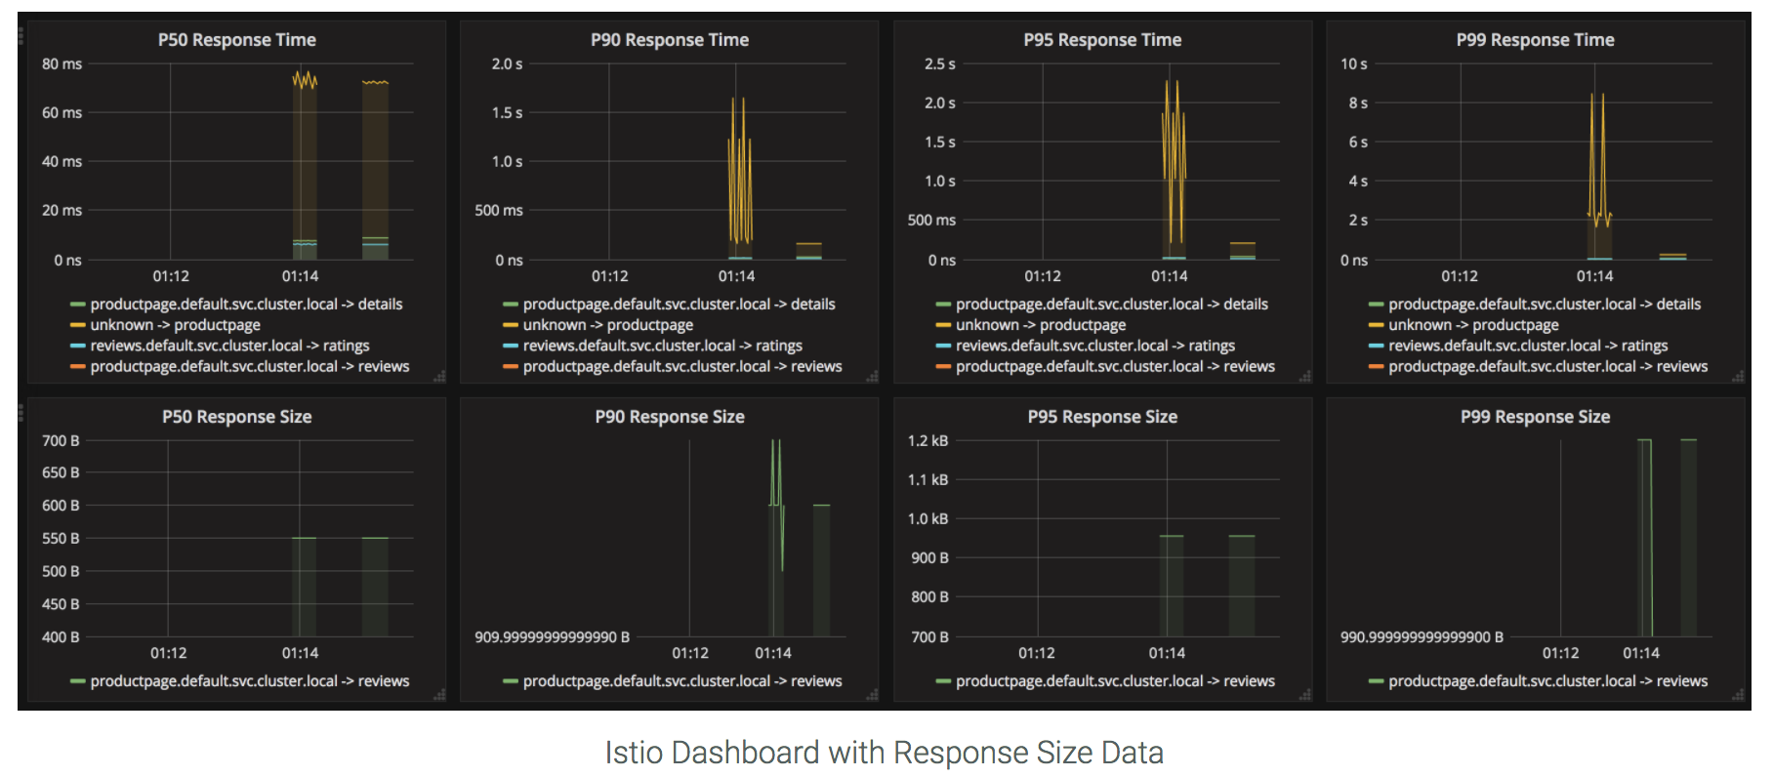
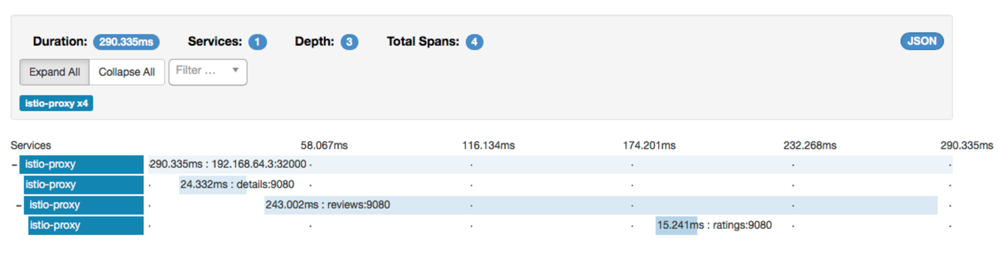
Visibility
Monitoring & tracing should not be an afterthought in the infrastructure
Goals
Metrics without instrumenting apps
Consistent metrics across fleet
Trace flow of requests across services
Portable across metric backend providers
Istio - Grafana dashboard w/ Prometheus backend
Istio Zipkin tracing dashboard
Notes:
Baseline visibility even for black boxes. Holistic view of the entire fleet. No need to rely on development process to instrument code to emit metrics. Metrics are not special. Its just that every component emits metrics.
Consistent metrics enables automation - things like autoscaling for example.
Policy engines have to operate on same data that telemetry systems have. Right now, we operate on two inconsistent data streams.
Log scrapping is an after thought.
In addition, the sidecars are ideally positioned to trace the flow of requests across services, when you need to drill down on performance issues or trouble shoot problems in the application.

Slide 43







Visibility: Metrics
Requests
Requests
Proxy
Service
Responses
Responses
Traces
Zipkin
Mixer collects metrics emitted by Istio Proxy
Adapters in the Mixer normalize and forward to monitoring backends
Metrics backend can be swapped at runtime
Check(attributes)
Report([ ]attributes)
Mixer
Operator Supplied Config
Adapters
Backends
Prometheus
Stackdriver
Statsd
GUIs
ServiceGraph Example
Grafana
Weave Scope

Slide 44
Visibility: Tracing
Requests
Requests
Proxy
Service
Responses
Responses
Traces
Zipkin
Application do not have to deal with generating spans or correlating causality
Proxy generate spans
Applications need to forward context headers on outbound calls
Proxy send traces to Mixer
Adapters at Mixer send traces to respective backends
Check(attributes)
Report([ ]attributes)
Mixer
Operator Supplied Config
Adapters
Backends
Prometheus
Stackdriver
Statsd
GUIs
ServiceGraph Example
Grafana
Weave Scope

Slide 45
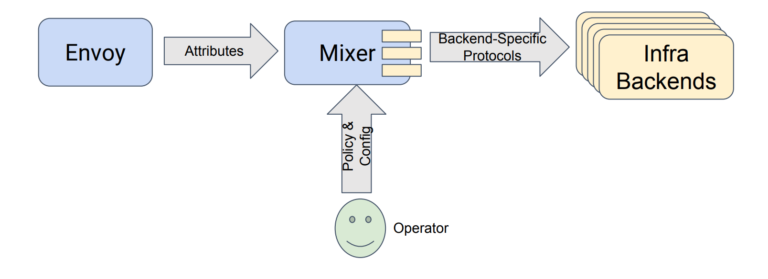
Mixer is an attribute-processing and routing machine.

Slide 46
Mixer Core Features
Precondition Checking - consumer properly authenticated? whitelisted?
Quota Management - Allocate and free quota dynamically
Telemetry Reporting
Notes:
Point of integration with infrastructure backends - allows you to extend the mesh to integrate features from your existing infrastructure
Facilitates platform & environment mobility. Can move services around more easily within the mesh & hybrid-cloud
Designed for operators to control the behavior of the mesh
Enable features mesh wide or on a specific service or on the relationship between two services

Slide 47
What’s Mixer For?
Enforcing Access Control and Usage Policies
Proxy extracts request attributes which are sent to Mixer for evaluation
Primary point of extensibility
Enabler for platform mobility
Operator-focused configuration model
Backend Abstraction
Notes:
Point of integration with infrastructure backends - allows you to extend the mesh to integrate features from your existing infrastructure
Facilitates platform & environment mobility. Can move services around more easily within the mesh & hybrid-cloud
Designed for operators to control the behavior of the mesh
Enable features mesh wide or on a specific service or on the relationship between two services
Backend Abstraction. Mixer insulates the Istio components and services within the mesh from the implementation details of individual infrastructure backends.

Slide 48
Mixer Policies
Quota policies
Monitoring policies
Metrics, logging, tracing
Security policies
Service-to-service mTLS authentication
Simple authorization: denier, white/black list, expression language
(RBAC)
Notes:
Point of integration with infrastructure backends - allows you to extend the mesh to integrate features from your existing infrastructure
Facilitates platform & environment mobility. Can move services around more easily within the mesh & hybrid-cloud
Designed for operators to control the behavior of the mesh
Enable features mesh wide or on a specific service or on the relationship between two services
Backend Abstraction. Mixer insulates the Istio components and services within the mesh from the implementation details of individual infrastructure backends.

Slide 49
Plugin Model for Extensibility
Mixer
Mixer uses pluggable adapters to extend its functionality
Adapters are modules that interface to infrastructure backends
They expose specialized interfaces (logging, metrics, quotas, etc)
Multi-interface adapters are possible (e.g., a Stackdriver adapter exposing logging & monitoring)
Adapters run in Mixer process, or
As gRPC services called by Mixer
IBM Cloud
GCP
AWS
Prometheus
Heapster
New Relic
Notes:
Fairly self-explanatory
Lead in to attributes as the underpinning.

Slide 50
Attributes - The behavioral vocabulary
destination.service = “playlist.svc.cluster.local”
request.size = 345
request.time = 2017-04-12T12:34:56Z
source.ip = 192.168.10.1
source.name = “music-fe.serving.cluster.local”
source.user = “admin@musicstore.cluster.local”
api.operation = “GetPlaylist”
Notes:
Everything is built off a vocabulary that describes behaviors that occur within the mesh
HTTP request, connection creation etc.
Because we inject proxies at both the origin and the destination of traffic we have a lot of information available that can be used to drive operational policy
From the example
The name of the addressed service - typical stuff
Details about the payload - again pretty normal
Source.user - from Istio auth
Drive ACLs based onthis
api.operation ? Example of customization
Hypothetical classifier of traffic based on OpenAPI
Goal is to have Envoy produce these extremely efficiently, Mixer provides an execution pipeline that operates on a context of attributes.

Slide 51
Attributes
Typed name-value tuples that describe behaviors within the mesh
Base vocabulary
Extensible
Proxy and Services produce attributes, Mixer consumes them
Attributes are fundamental to how operators experience Istio
Notes:
Examples of extensibility
Classifier for OpenAPI traffic - produce attributes to label traffic with operation ids
Additional metadata about principals - extracted from internal auth system
Expand on why services would produce attributes
Resource consumption in storage or compute jobs - enforce quotas
Most of what you’ll be doing in configuring Istio is defining a mapping between the attributes being produced in the mesh and the operational behaviors you want to enforce.
Basis for future policy language work

Slide 52
Mixer Impact on Availability and Latency
Mixer is in the request path - is the impact negative or positive?
Stateless and horizontally scalable
Hardening - Designed to be highly reliable
Caching of Precondition Checks
Proxy caches precondition checks in a L1 cache
Mixer Provides a Shared L2 Cache
Mixer only called once for every several thousand requests
Telemetry Reporting - Buffered and Async
Notes:
https://istio.io/blog/2017/mixer-spof-myth.html
The Envoy sidecar logically calls Mixer before each request to perform precondition checks, and after each request to report telemetry. The sidecar has local caching such that a relatively large percentage of precondition checks can be performed from cache. Additionally, the sidecar buffers outgoing telemetry such that it only actually needs to call Mixer once for every several thousands requests. Whereas precondition checks are synchronous to request processing, telemetry reports are done asynchronously with a fire-and-forget pattern.

Slide 53
Changes needed to Legacy Applications
Modify request headers to pass span ids
x-request-id
x-b3-traceid
x-b3-spanid
x-b3-parentspanid
x-b3-sampled
x-b3-flags
x-ot-span-context

Slide 54
Exercise 8 & 9
Telemetry
Distributed Tracing

Slide 55
Traffic Splitting
serviceB.example.cluster.local
// A simple traffic splitting rule
destination: serviceB.example.cluster.local
match: source: serviceA.example.cluster.local route: - tags: version: v1.5
env: us-prod
weight: 99
- tags: version: v2.0-alpha
env: us-staging
weight: 1
Pod Labels:
version: v1.5
env: us-prod
Rules API
Pilot
Proxy
Traffic routing rules
99%
svcB
Pod
Service B
Proxy
Proxy
1%
http://serviceB.example
svcA
svcB
Traffic control is decoupled from infrastructure scaling
Service A
Pod Labels:
version: v2.0-alpha, env:us-staging
Notes:
Traffic control is decoupled from infrastructure scaling - i.e., the proportion of traffic routed to a version is independent of number of instances supporting the version
You can program these traffic routing rules using istio on the fly using simple rules as shown in the slide. These rules get translated into low level Envoy configs. Envoy periodically fetches configs from the manager and updates its internal routing table. There are no hot restarts, no impact to existing traffic.
We call this tag based routing.

Slide 56
Traffic Steering
Service B
version: v1
// Content-based traffic steering rule
destination: serviceB.example.cluster.local match: httpHeaders: user-agent: regex: ^(.*?;)?(iPhone)(;.*)?$ precedence: 2 route: - tags: version: canary
Pod 1
Pod 2
svcA
Pod 3
svcB
Service A
Service B
version: v1
Pod 1
User-agent: *Android*
Pod 2
Pod 3
svcA
svcB
Content-based traffic steering
Service A
User-agent: *iPhone*
Pod 4
svcB’
version: canary
Notes:
Content-based traffic steering - The content of a request can be used to determine the destination of a request
Another way to route requests is the age old method. Look at the contents of a request and route it to a specific set of instances. This opens up all sorts of possibilities. For a user facing service, you could route a portion of mobile traffic from a particular device, say an iPhone, to a specific version of the service. For internal services, callers would have the ability to explicitly request a particular version of the service. In fact, Verizon is using this particular technique in production today.

Slide 57
Istio Rules Configuration
Route Rules - Defines how requests are routed within the service mesh
Destination Policies - Routing related policies for a service, i.e. load balancing algorithm or circuit breaker
Egress Rules

Slide 58
Route Rules
Qualify Rules by Destination - Name of Service
Qualify rules by source/headers
Match rule to a specific caller
Restrict to a specific version of the caller
Match rule to HTTP Header Values
Split traffic between service versions - see route-rule-80-20.yaml
Timeouts and retries - see route-rule-retry.yaml
Injecting Faults - see route-rule-delay-guestbook.yaml
Rules have precedence - Rules with higher precedence values are evaluated first.

Slide 59
Route Discovery Service (RDS)
Istio-proxy sidecars keep a representation of the configured, “discoverable” services and clusters.
Services registered with RDS API available by querying the Istio Proxy
kubectl port-forward helloworld-service-v1-fd94c8576-5ttqc 15000:15000
curl localhost:15000/routes

Slide 60
Exercise 10 & 11
Exercise 10 - Request Routing and Canary Testing
Exercise 11 - Service Isolation Using Mixer

Slide 61
Resiliency
Istio adds fault tolerance to your application without any changes to code
Resilience features
Timeouts
Retries with timeout budget
Circuit breakers
Health checks
AZ-aware load balancing w/ automatic failover
Control connection pool size and request load
Systematic fault injection
Notes:
time-outs are a very useful tool, and they are a double-edged sword if you are not careful, they are an important tool in the toolbox to make sure that the system stays stable. Maybe you want to, you know, try to read from a remote service, if the read fails in a certain unit of time, I can read out of a cache or data structure and still serve content to the user.
So time-outs do things that help you like that. And re-tries are on the sharp end of the timeout world, you are cascading outages, that is another example of accidental attacks. So circuit breakers, health checking, and maybe your application is big enough to span many regions and you want to make sure that it routes traffic appropriately when bad things happen.
In our experience working with a diverse set of clients, 95% of them are happy with an out of process sidecar implementing all the resiliency features such as circuit breakers instead of having to build them into the application code.
Secondly, in most of the cases, there is a fair amount of parameter tweaking - e.g., making sure that timeouts across services are not too tight or ensuring that a circuit doesn’t open too early.
Istio provides dynamically configurable resilience features that you can tweak at runtime, *in production*.

Slide 62
Circuit Breaking
destination: serviceB.example.cluster.local policy: - tags: version: v1 circuitBreaker: simpleCb: maxConnections: 100 httpMaxRequests: 1000 httpMaxRequestsPerConnection: 10 httpConsecutiveErrors: 7 sleepWindow: 15m httpDetectionInterval: 5m
Notes:
In our experience working with a diverse set of clients, 95% of them are happy with an out of process sidecar implementing all the resiliency features such as circuit breakers instead of having to build them into the application code.
Secondly, in most of the cases, there is a fair amount of parameter tweaking - e.g., making sure that timeouts across services are not too tight or ensuring that a circuit doesn’t open too early.
Istio provides dynamically configurable resilience features that you can tweak at runtime, *in production*.

Slide 63
HTTP Timeout
metadata:
name: my-rule
namespace: default
spec:
destination:
name: ratings
route:
- labels:
version: v1
httpReqTimeout:
simpleTimeout:
timeout: 10s
Notes:
In our experience working with a diverse set of clients, 95% of them are happy with an out of process sidecar implementing all the resiliency features such as circuit breakers instead of having to build them into the application code.
Secondly, in most of the cases, there is a fair amount of parameter tweaking - e.g., making sure that timeouts across services are not too tight or ensuring that a circuit doesn’t open too early.
Istio provides dynamically configurable resilience features that you can tweak at runtime, *in production*.

Slide 64
HTTP Retry
metadata:
name: my-rule
namespace: default
spec:
destination:
name: ratings
route:
- labels:
version: v1
httpReqRetries:
simpleRetry:
attempts: 3
perTryTimeout: 2s
Notes:
In our experience working with a diverse set of clients, 95% of them are happy with an out of process sidecar implementing all the resiliency features such as circuit breakers instead of having to build them into the application code.
Secondly, in most of the cases, there is a fair amount of parameter tweaking - e.g., making sure that timeouts across services are not too tight or ensuring that a circuit doesn’t open too early.
Istio provides dynamically configurable resilience features that you can tweak at runtime, *in production*.

Slide 65
Rate Limits
apiVersion: config.istio.io/v1alpha2
kind: memquota
metadata:
name: handler
spec:
quotas:
- name: requestcount.quota.istio-system
maxAmount: 5000
validDuration: 1s
overrides:
- dimensions:
destination: ratings
source: reviews
sourceVersion: v2
maxAmount: 1
validDuration: 1s
apiVersion: config.istio.io/v1alpha2
kind: quota
metadata:
name: requestcount
namespace: istio-system
spec:
dimensions:
source: source.labels["app"] | source.service | "unknown"
sourceVersion: source.labels["version"] | "unknown"
destination: destination.labels["app"] | destination.service | "unknown"
destinationVersion: destination.labels["version"] | "unknown"
---
apiVersion: config.istio.io/v1alpha2
kind: rule
metadata:
name: quota
namespace: istio-system
spec:
actions:
- handler: handler.memquota
instances:
- requestcount.quota

Slide 66
Resiliency Testing
Systematic fault injection to identify weaknesses in failure recovery policies
HTTP/gRPC error codes
Delay injection
Timeout: 100ms
Retries: 3
300ms
Timeout: 200ms
Retries: 2
400ms
Proxy
Proxy
Proxy
svcA
svcB
svcC
Service A
Service B
Service C
Notes:
Systematic resilience testing allows you to test the ability of your services to recover from failures. You can isolate failures to specific subset of requests (such as those coming from QA teams), while running these tests in production.
If you recall the excellent Linkerd talk that Oliver gave this morning, he talked about a scenario where a chain of service calls had incompatible timeouts and retries. Well, you can always recover from these issues by using timeouts/retries/circuit breakers on the very first service in the call chain. But think of all the wasted work in the backend services (resources being held up).
Worse yet, think of the impact on your users. For example, consider Netflix recommendations. When the system is running well, you get personalized recommendations. That is a “feature”. When the personalized recommendations system is down, Netflix falls back to “generic recommendations”. This is great as long as the outage is temporary. But what if this becomes the permanent user experience for weeks at a stretch, because some frontend system had a misconfigured timeout that caused it to prematurely terminate API calls to the recommendation engine.

Slide 67
Exercise 12
Exercise 12 - Fault Injection and Rate Limiting

Slide 68
Securing Microservices
Verifiable identity
Secure naming / addressing
Traffic encryption
Revocation

Slide 69
Problem: Strong Service Security at Scale
Concerns
Concerned about insider access risks
Adopting a (micro-)services architecture
Audit & Compliance
Issues
Modern architectures are based on dynamically placed workloads and remotely accessed shared (micro-)services.
Existing network based security paradigms either enable broad access within a network or are brittle / hard to manage.
Customers want a way to limit sensitive data access to only limited services (or identities) and enforce strong authentication at scale.
Notes:
Concerns - Do you care about insider access risks? Microservices can increase exposure
APIs between services imply a more accessible attack surface
Accidental exposure of services through HTTP gateways
Segregation of business units
Issues - Tools like K8S provide greater flexibility with how workloads are placed.
Can be hard to keep up with common tools - Firewalls & ip whitelists
Also expensive!
Good ACL solutions are emerging at L4 (Covalent, Tigera, Aporeto etc.) ...
… but still want hardening that will meet compliance requirements

Slide 70
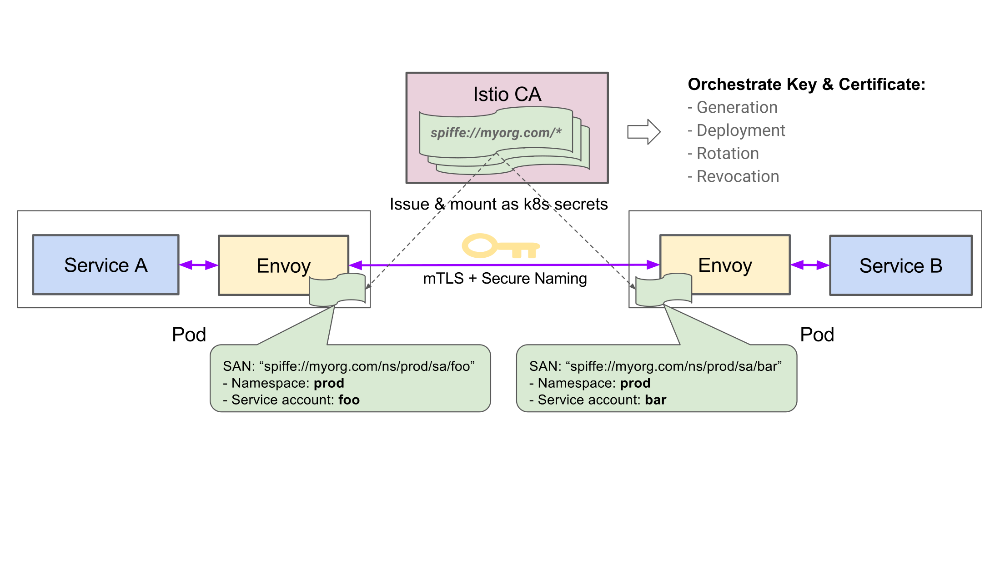
Istio - Security at Scale
spiffe.io
Notes:
Walk through the flow
Istio CA deployed that mints certs for K8S service accounts
Certs adhere to the SPIFFE spec
Certs distributed to Envoy sidecars using K8S secrets
Envoy uses keys to enable mTLS without application involvement
Identities are propagated to backends via standard headers
Policies can be enforced on these identities
Defense in depth - Certificates are automatically rotated, can be revoked
Defense in depth - Secure naming - prevent DNS spoofing attacks by associating service-account with name.
Setup responsive to K8S autoscaling
no need for manual intervention
no need for firewalls - can have a completely flat network
Next steps
Integrate certificate management & storage systems (e.g. Vault, HSMs etc)

Slide 71
Exercise 13
Exercise 13 - Security

Slide 72
Problem: Controlling who does what
Need to identify caller (SPIFFE, cookie, etc)
Authorization templates define how to identify the caller and what actions (services, methods, paths) the policy applies to
ServiceRoles describe the various roles and their capabilities
ServiceRoleBindings put it all together, describing which callers (usually services) get which roles.
Notes:
Concerns - Do you care about insider access risks? Microservices can increase exposure
APIs between services imply a more accessible attack surface
Accidental exposure of services through HTTP gateways
Segregation of business units
Issues - Tools like K8S provide greater flexibility with how workloads are placed.
Can be hard to keep up with common tools - Firewalls & ip whitelists
Also expensive!
Good ACL solutions are emerging at L4 (Covalent, Tigera, Aporeto etc.) ...
… but still want hardening that will meet compliance requirements

Slide 73
Istio RBAC
Authorization policy
Service Role
apiVersion: "config.istio.io/v1alpha2"
kind: authorization
metadata:
name: requestcontext
namespace: istio-system
spec:
subject:
user: source.user | ""
groups: ""
properties:
app: source.labels["app"] | ""
version: source.labels["version"] | ""
namespace: source.namespace | ""
action:
namespace: destination.namespace | ""
service: destination.service | ""
method: request.method | ""
path: request.path | ""
properties:
app: destination.labels["app"] | ""
version: destination.labels["version"] | ""
Version: "config.istio.io/v1alpha2"
kind: ServiceRole
metadata:
name: details-reviews-viewer
namespace: default
spec:
rules:
- services: ["details.default.svc.cluster.local"]
methods: ["GET"]
- services: ["reviews.default.svc.cluster.local"]
methods: ["GET"]
constraints:
- key: "version"
values: ["v2", "v3"]

Slide 74
Istio RBAC
Service Role Binding
apiVersion: "config.istio.io/v1alpha2"
kind: ServiceRoleBinding
metadata:
name: bind-details-reviews
namespace: default
spec:
subjects:
- user: "cluster.local/ns/default/sa/bookinfo-productpage"
roleRef:
kind: ServiceRole
name: "details-reviews-viewer

Slide 75
Exercise 14
Exercise 14 - Istio RBAC

Slide 76
THANK YOU!!

Slide 77
Zack’s old slides

Slide 78
Setup
Clone the Install to Ops repo:
kubectl config get-contexts
Make sure you have permission to create cluster role bindings:
Download kubectl version 1.7.5 if you don’t have it:
curl -LO https://storage.googleapis.com/kubernetes-release/release/v1.7.5/bin/darwin/amd64/kubectl chmod +x ./kubectl
sudo mv ./kubectl /usr/local/bin/kubectl
git clone git@github.com:ZackButcher/install-to-ops.git
kubectl create clusterrolebinding cluster-admin-binding \
--clusterrole=cluster-admin \
--user=devstar*@gcplab.me

Slide 79
Overview
Install Istio into our cluster
Deploy our app
Explore telemetry
Explore traffic management

Slide 80
Install Istio
From the root of the github repo:
This deploys Istio’s control plane and an initializer that deploys Istio sidecar automatically.
kubectl apply -f istio-auth.yaml
kubectl apply -f istio-initializer.yaml

Slide 81
Install Addons
From the root of the github repo:
This deploys Zipkin, Grafana, Prometheus, and ServiceGraph
kubectl apply -f ./addons

Slide 82
Deploy Our App
From the root of the github repo:
kubectl apply -f bookinfo.yaml
Reviews v1
Product Page
Details

Slide 83
Deploy Our App
View the product page via its public IP:
kubectl get ingress
Reviews v1
Product Page
Details

Slide 84
Telemetry
kubectl -n istio-system port-forward \
$(kubectl -n istio-system get pod \
-l app=grafana -o jsonpath='{.items[0].metadata.name}') \
3000:3000 &
Check out grafana at http://localhost:3000/dashboard/db/istio-dashboard

Slide 85
Traffic Management
Canary deployments:
cat <<EOF | kubectl create -f -
apiVersion: config.istio.io/v1alpha2
kind: RouteRule
metadata:
name: reviews-default
spec:
destination:
name: reviews
route:
- labels:
version: v1
EOF
Reviews v2
Ratings
Reviews v1
Product Page
Details
kubectl apply -f reviews-v2.yaml

Slide 86
Traffic Management
Canary deployments:
Reviews v2 returns stars with its ratings, while Reviews v1 returns no stars.
Reviews v2
Ratings
Reviews v1
Product Page
Details

Slide 87
Traffic Management
Canary deployments:
cat <<EOF | kubectl replace -f -
apiVersion: config.istio.io/v1alpha2
kind: RouteRule
metadata:
name: reviews-default
spec:
destination:
name: reviews
precedence: 2
route:
- labels:
version: v1
weight: 50
- labels:
version: v2
weight: 50
EOF
Reviews v2
Ratings
50%
Reviews v1
Product Page
50%
Details

Slide 88
Traffic Management
Automatic request timeouts
cat <<EOF | kubectl replace -f -
apiVersion: config.istio.io/v1alpha2
kind: RouteRule
metadata:
name: reviews-default
spec:
destination:
name: reviews
precedence: 2
route:
- labels:
version: v1
weight: 50
- labels:
version: v2
weight: 50
httpReqTimeout:
simpleTimeout:
timeout: 1s
EOF
Reviews v2
Ratings
1s timeout
Reviews v1
1s timeout
Product Page
Details

Slide 89
Traffic Management
Fault injection
2s delay
cat <<EOF | kubectl create -f -
apiVersion: config.istio.io/v1alpha2
kind: RouteRule
metadata:
name: ratings-default
spec:
destination:
name: ratings
route:
- labels:
version: v1
httpFault:
delay:
percent: 100
fixedDelay: 2s
EOF
Reviews v2
Ratings
1s timeout
Reviews v1
1s timeout
Product Page
Details

Slide 90
Telemetry
Tracing with Zipkin
kubectl -n istio-system port-forward \
$(kubectl -n istio-system get pod \
-l app=zipkin -o jsonpath='{.items[0].metadata.name}') \
9411:9411 &
Check out Zipkin at http://localhost:9411

Slide 91
Telemetry
Understanding the deployment
kubectl -n istio-system port-forward \
$(kubectl -n istio-system get pod \
-l app=servicegraph -o jsonpath='{.items[0].metadata.name}') \
8088:8088 &
Check out ServiceGraph at http://localhost:8088/dotviz

Slide 92
Istio Networking?
Network connects the services
Istio provides the network policy
Isolate Workloads
Secure Communication

